Slide 1
BLACK FRIDAY SALES PREDICTION
BY
C K M GANESAN
18BCE1266

Slide 2
About
Black Friday sales dataset
By Retail Stores
550,000 observations
Contains:
Numerical Variables
Categorical Variables
Some missing values

Slide 3
R Packages Used
UsingR
sampling
stringr
tidyverse
stats
prob
dbplyr
Dtplyr
H20
RandomForest
gbm
Caret
Ggplot2
Dummies
rpart

Slide 4
Attributes in Data
User_ID (Numerical Variable)
Product_ID (Categorical Variable)
Gender (Categorical Variable)
Age (Categorical Variable, because it is in ranges)
Occupation (Numerical Variable)
City_Category (Categorical Variable)
Stay_In_Current_City_Years (Numerical Variable)
Marital_Status (Numerical Variable)
Product_Category_1 (Numerical Variable)
Product_Category_2 (Numerical Variable)
Product_Category_3 (Numerical Variable)
Purchase amount in dollars (Numerical Variable)

Slide 5
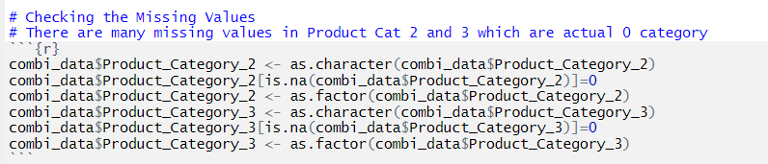
Data Cleaning
We have to convert the NA values into zero before processing.The columns Product category 2 and Product category 3 has NA values which should be converted into zero before using them for analysis and prediction.

Slide 6
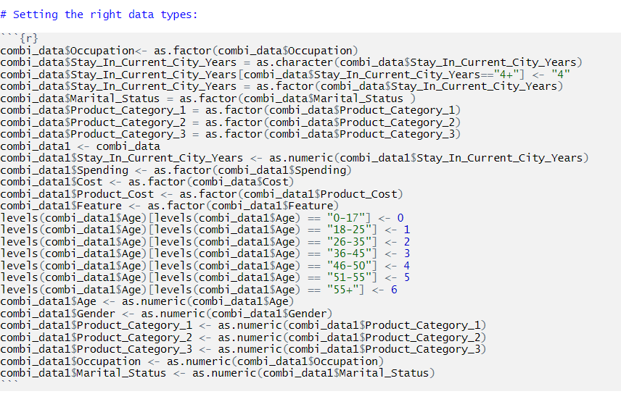
Data Cleaning
The variables must be set to their corresponding data types before processing. Categorical variables are assigned numerical values before using them for regression.

Slide 7
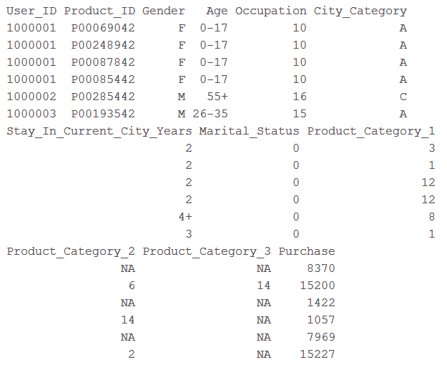
Exploring Attributes
User Id: Not Unique, maps person to the particular purchase
Product Id: Not Unique, tells how many purchases are made for a product
Gender: Have only two variables: F M
Age: It is divided into 7 ranges, Here Age is Categorical Variable
Occupation: There are 21 different occupation ranging from 0-21
City Category: Cities in which customers have lived is categorized into three categories: A, B, C
Year.. : People have lived in the current city for 0-5 years. Here 5 could mean atleast 5 years
Marital Status: People have their marriage status marked as either 0 or 1
Product Category 1: Ranges form 1-18
Product Category 2: Ranges form 2-18
Product Category 3: Ranges form 3-18
Purchase: It is the amount people spent in $ for purchases. Not unique.

Slide 8
Analysis..

Slide 9
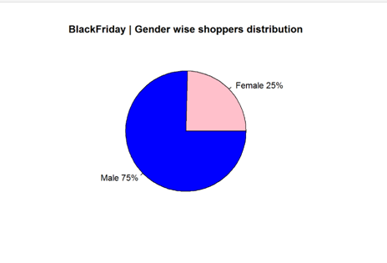
Analyse “Gender”

Slide 10
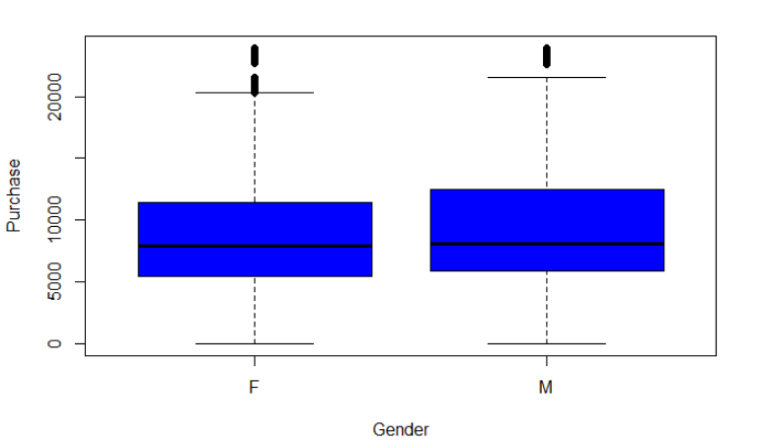
Analyse “Gender”

Slide 11
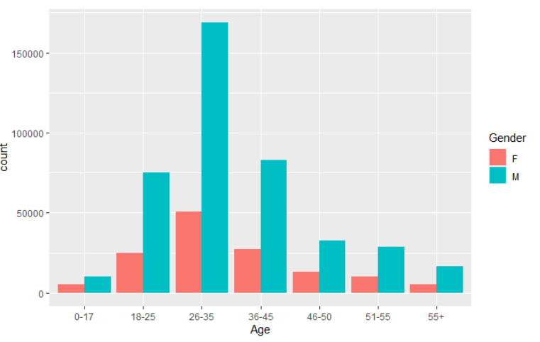
Analyse “Gender”

Slide 12
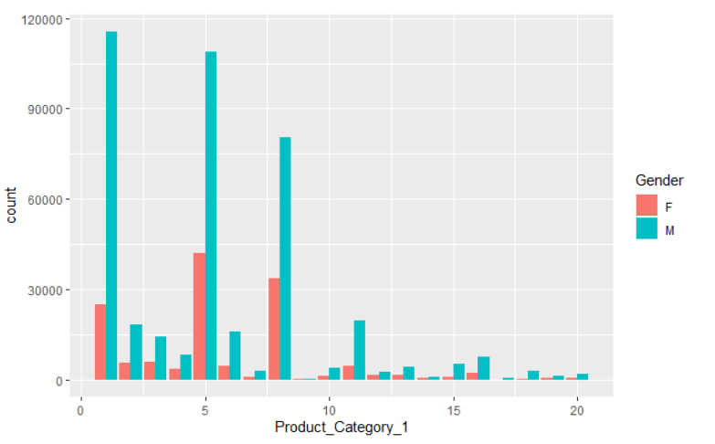
Analyse “Gender”

Slide 13
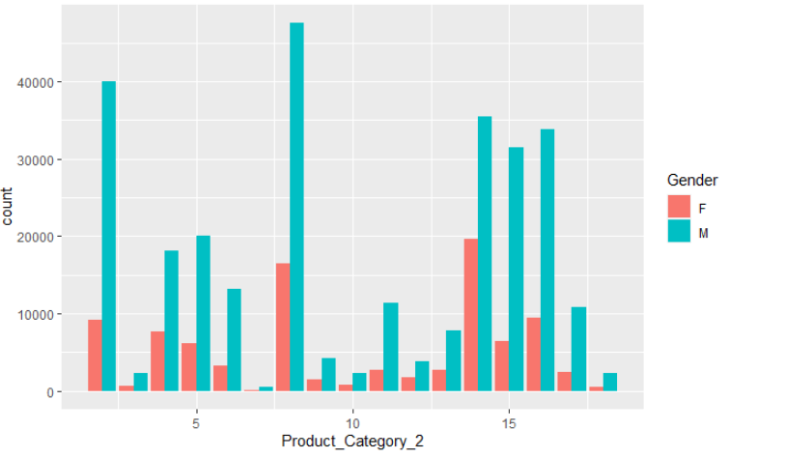
Analyse “Gender”

Slide 14
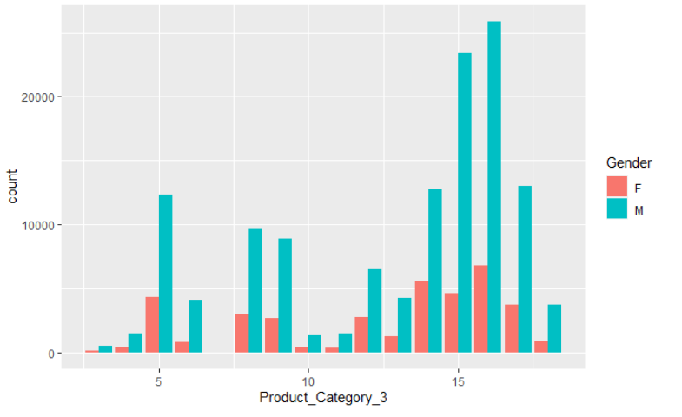
Analyse “Gender”

Slide 15
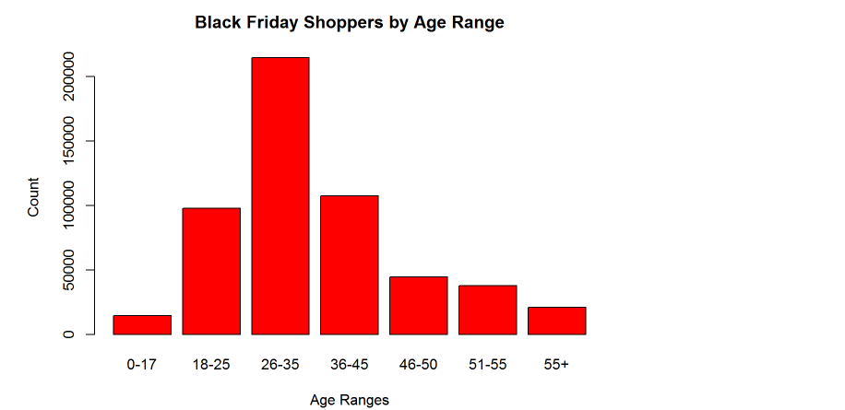
Analyse “Age-Range”

Slide 16
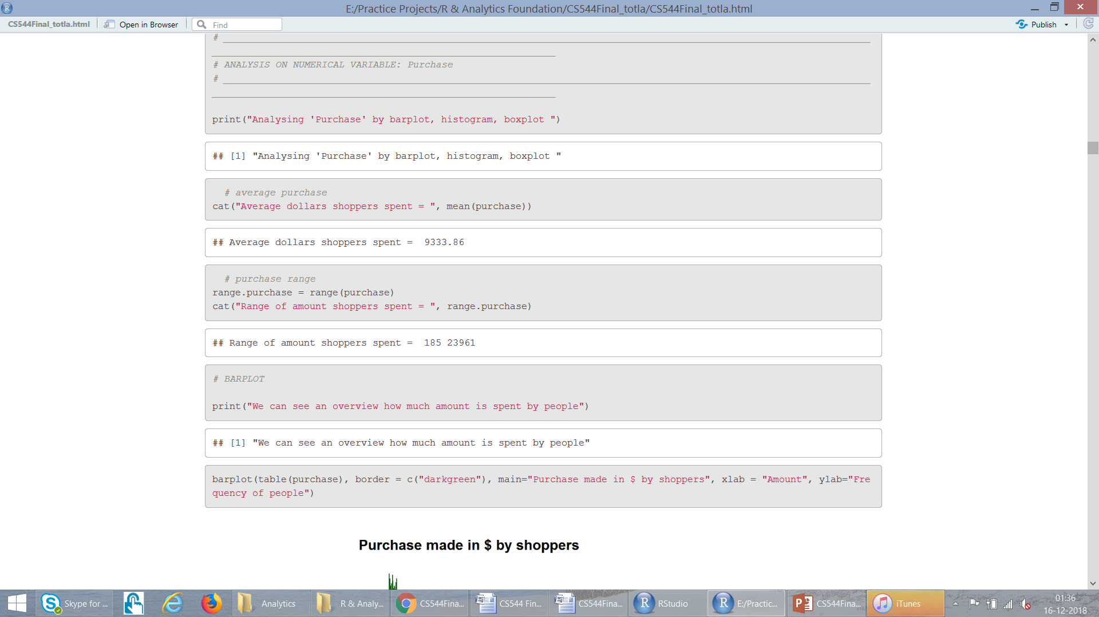
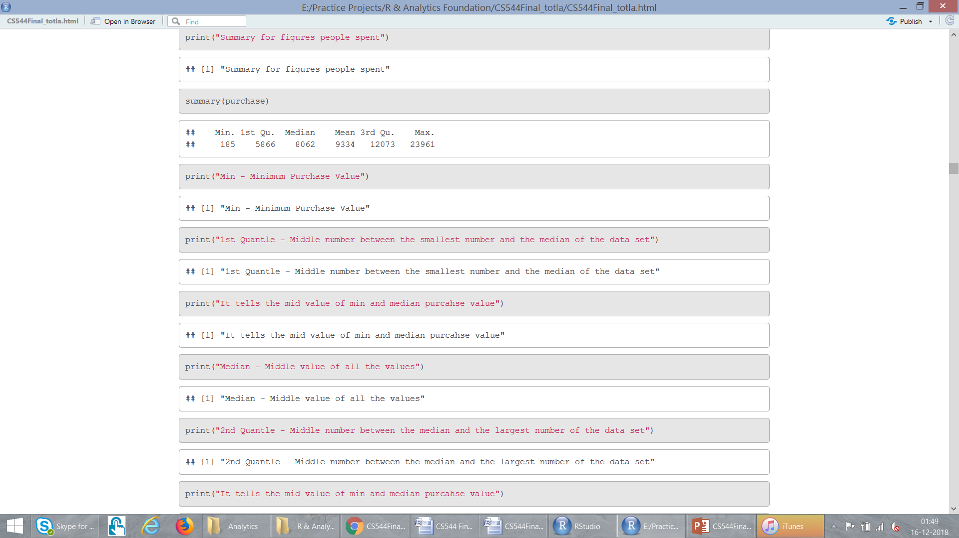
Analyse “Purchase”

Slide 17
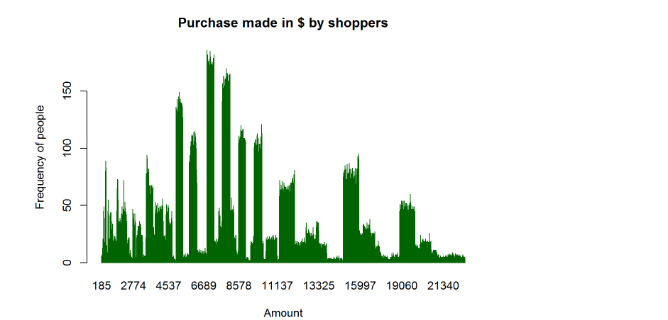

Analyse “Purchase” : Barplot

Slide 18
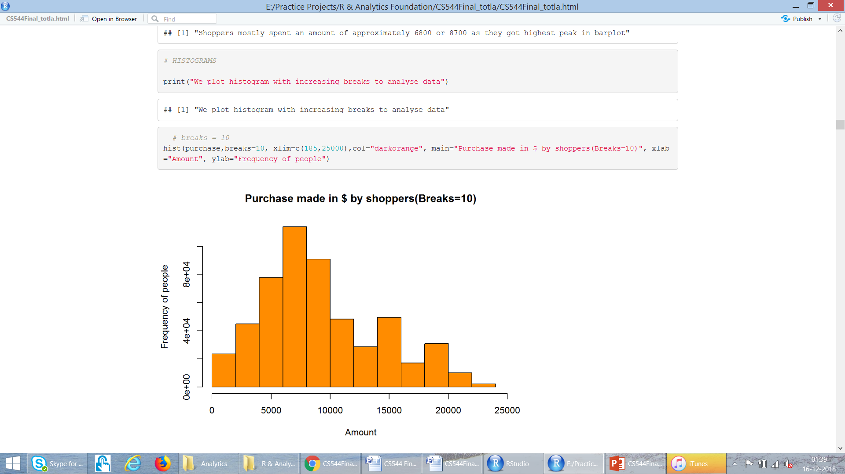
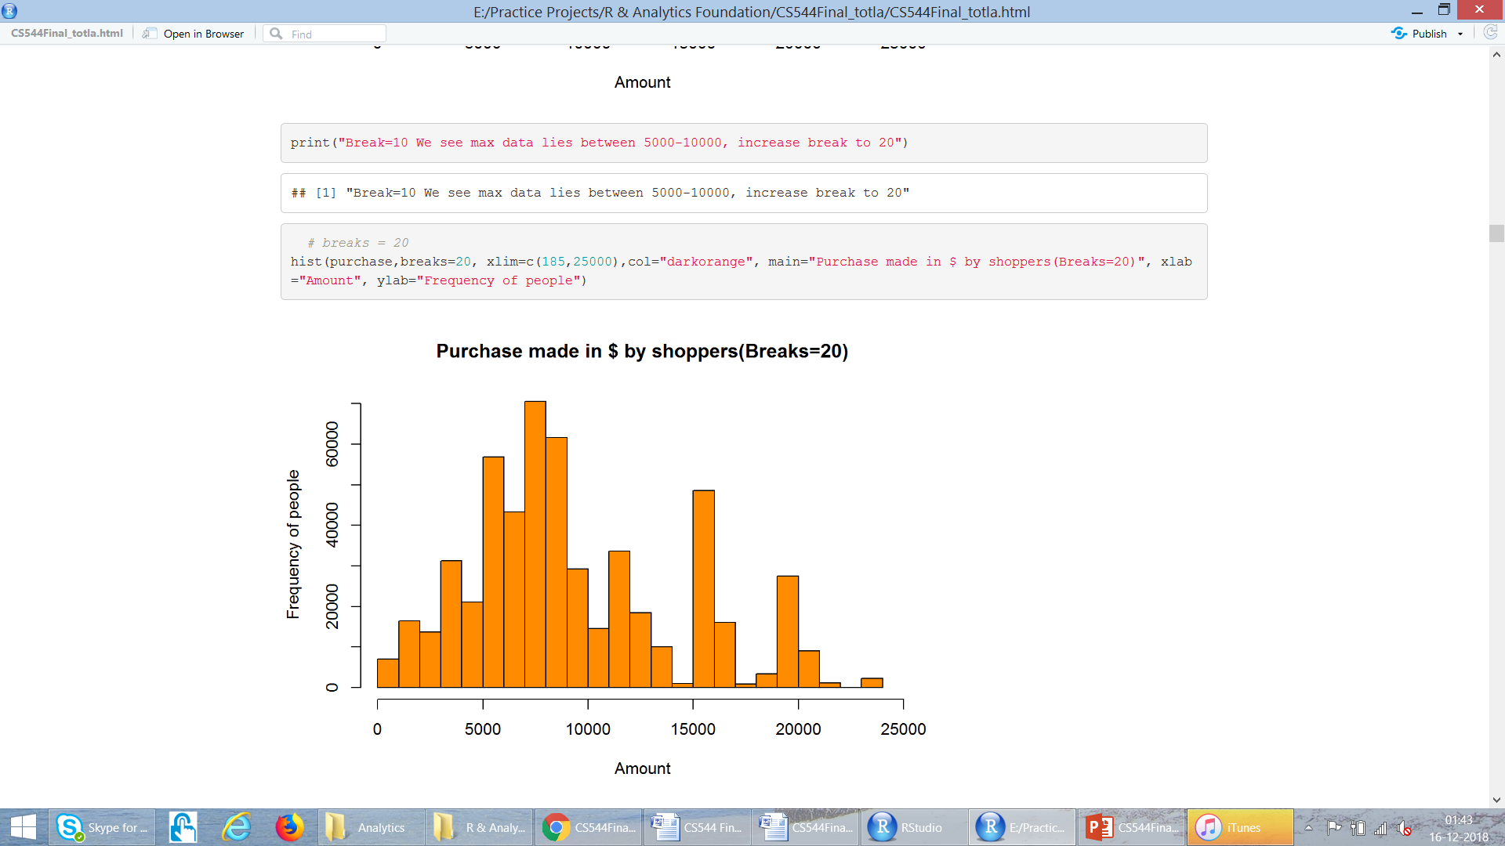
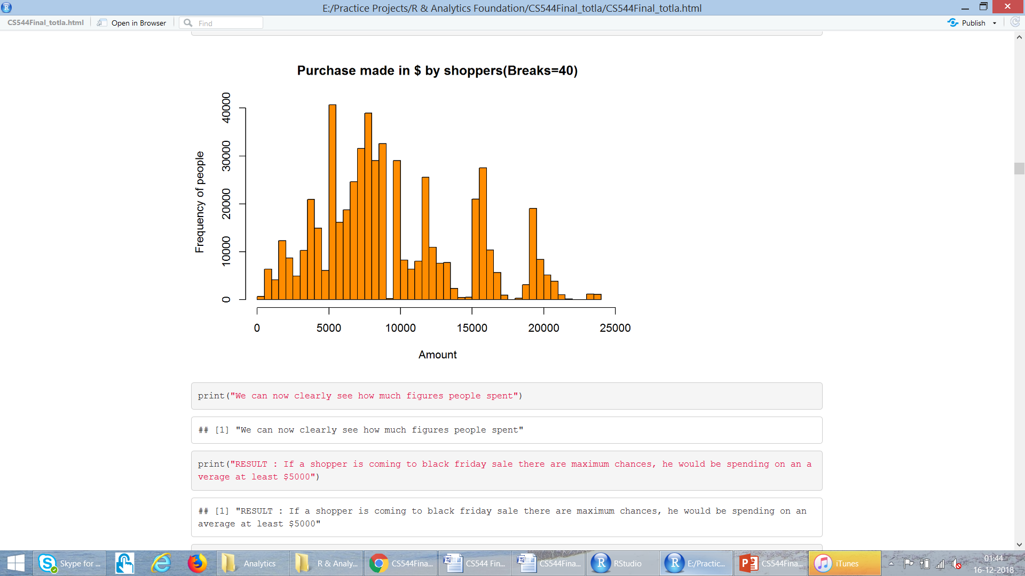
Analyse “Purchase” : Histograms

Slide 19
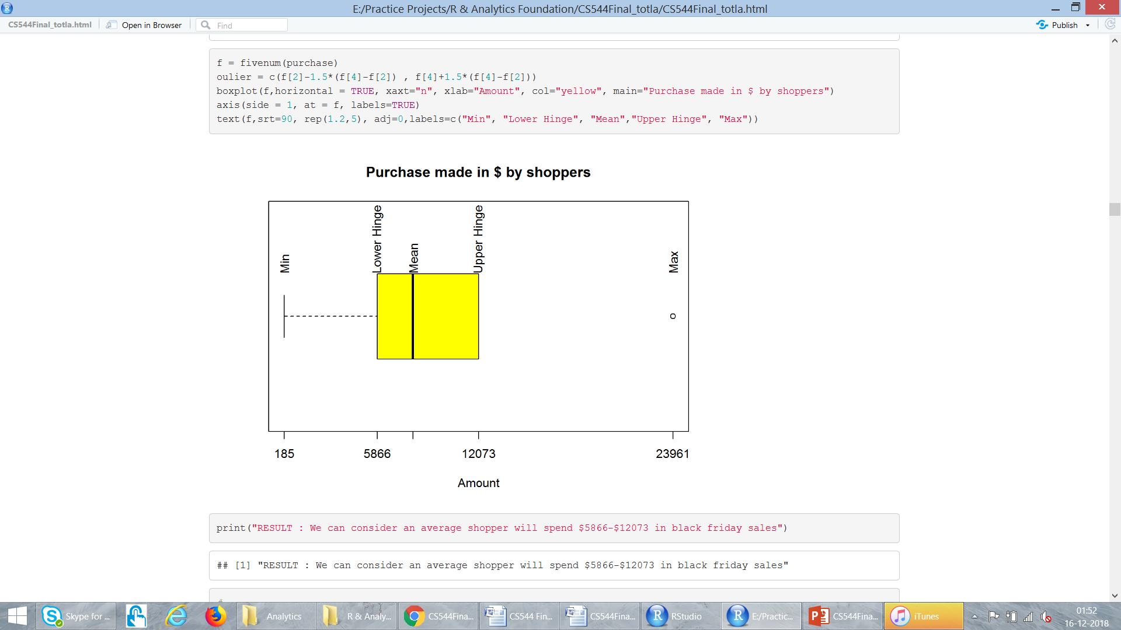
Analyse “Purchase” : Boxplot

Slide 20
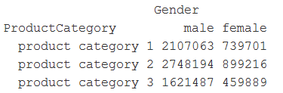
MULTIVARIATE DATA
Gender
Product Category 1
Product Category 2
Product Category 3

Slide 21
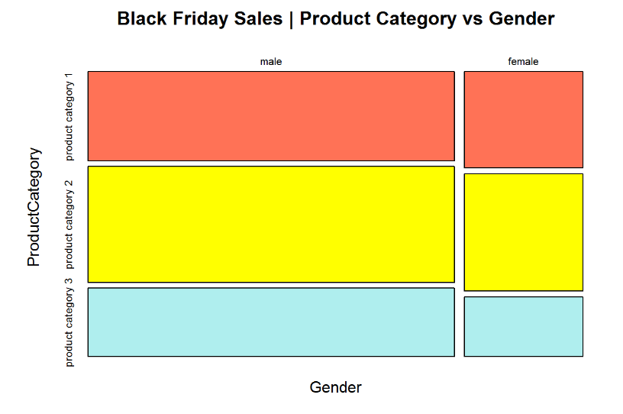
MULTIVARIATE DATA

Slide 22
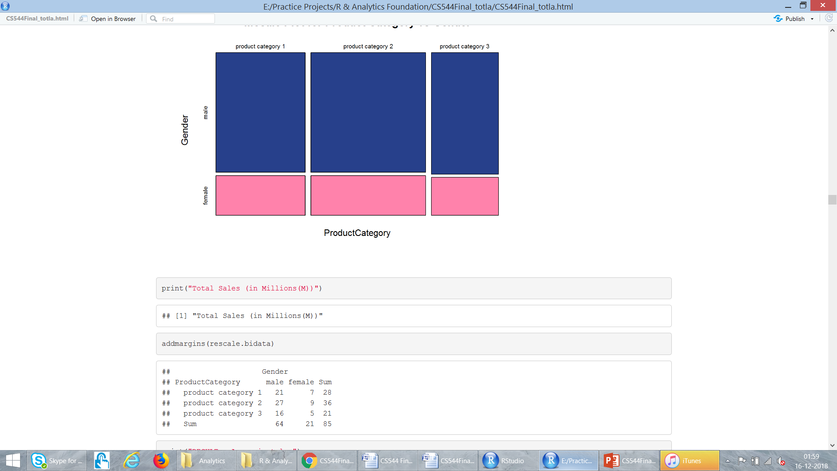
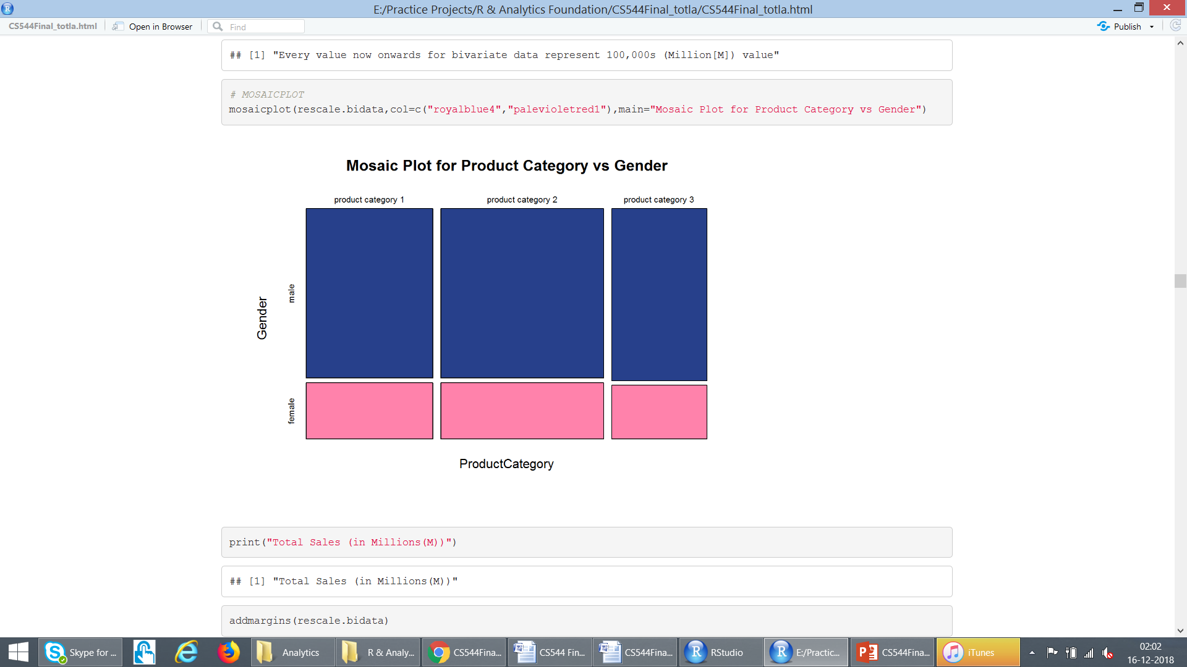
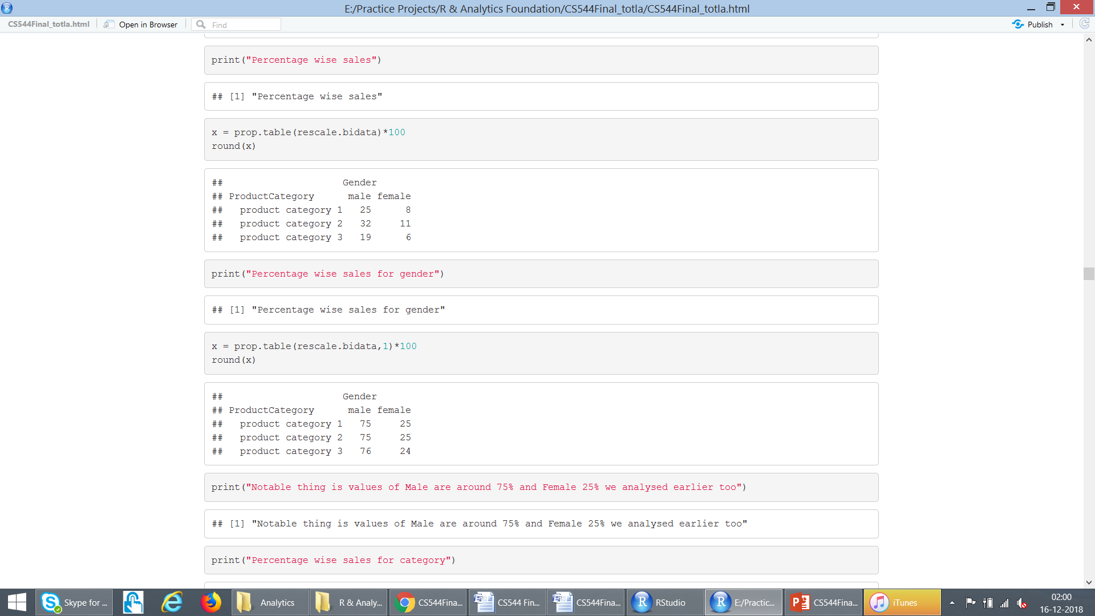
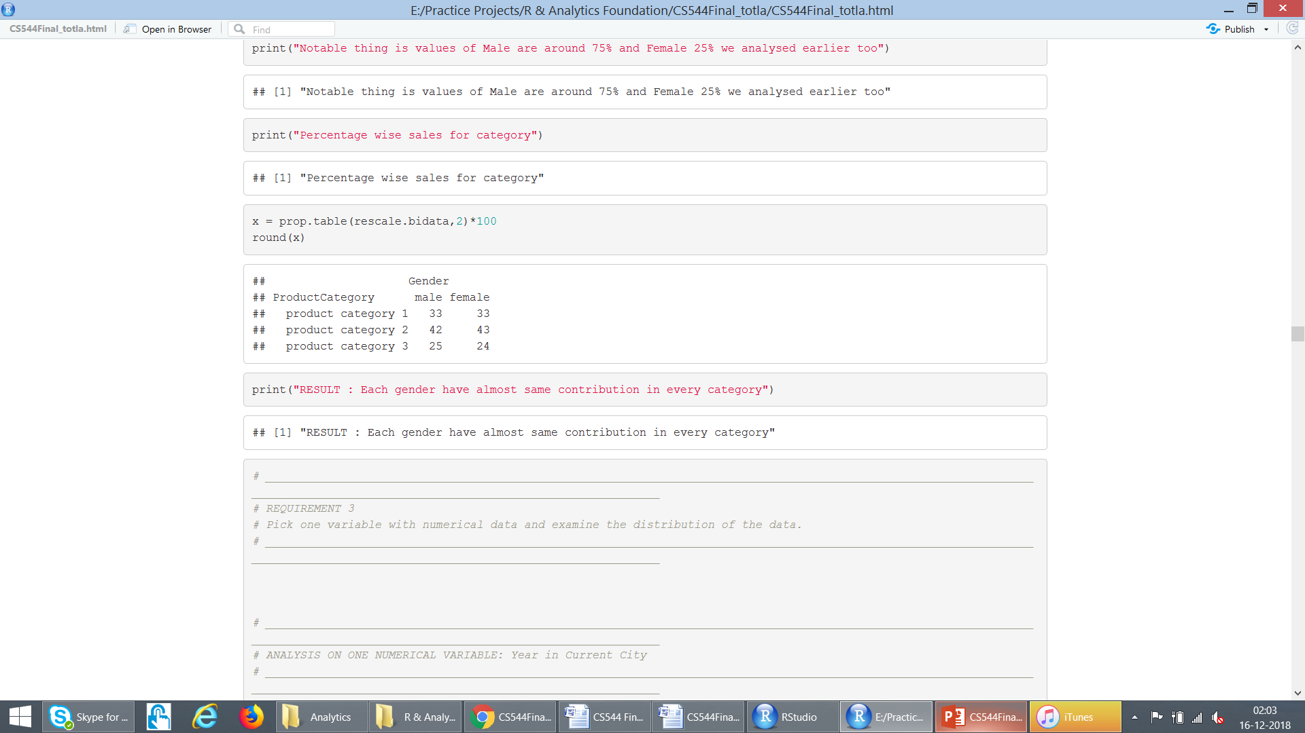
MULTIVARIATE DATA : Rescaled (values in Millions)
Overall
Gender
%tages
Product
Category
%tages

Slide 23
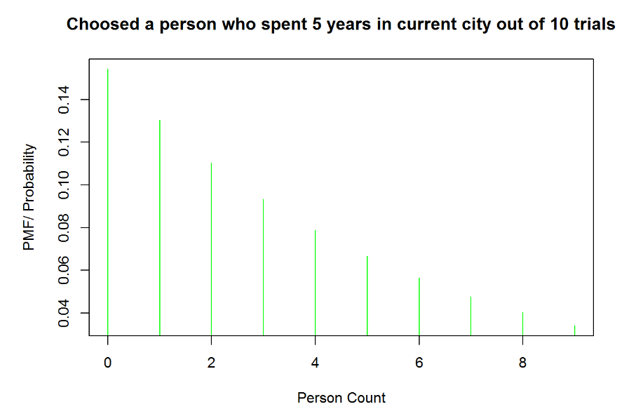
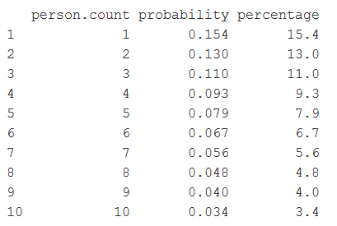
Analyse : “Years in Current City” Geometric Distribution

Slide 24
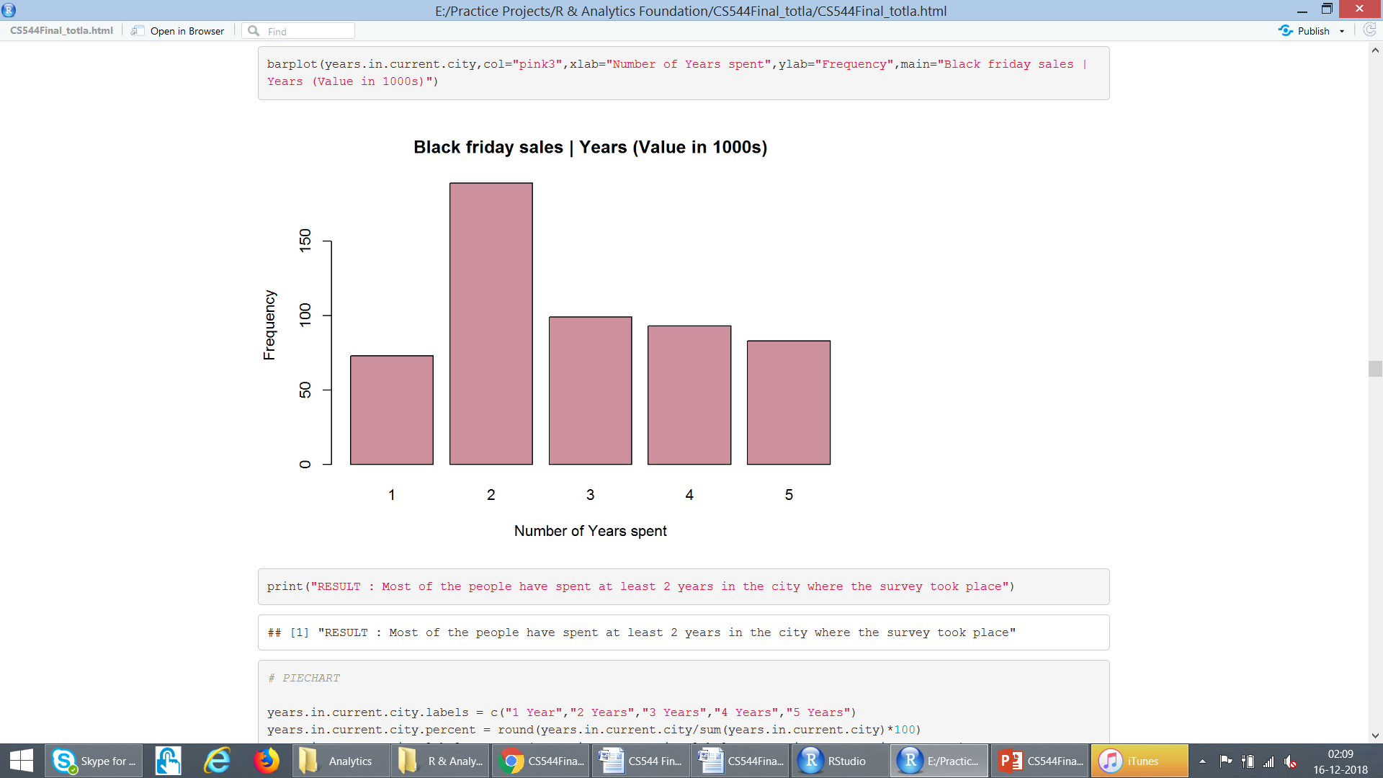
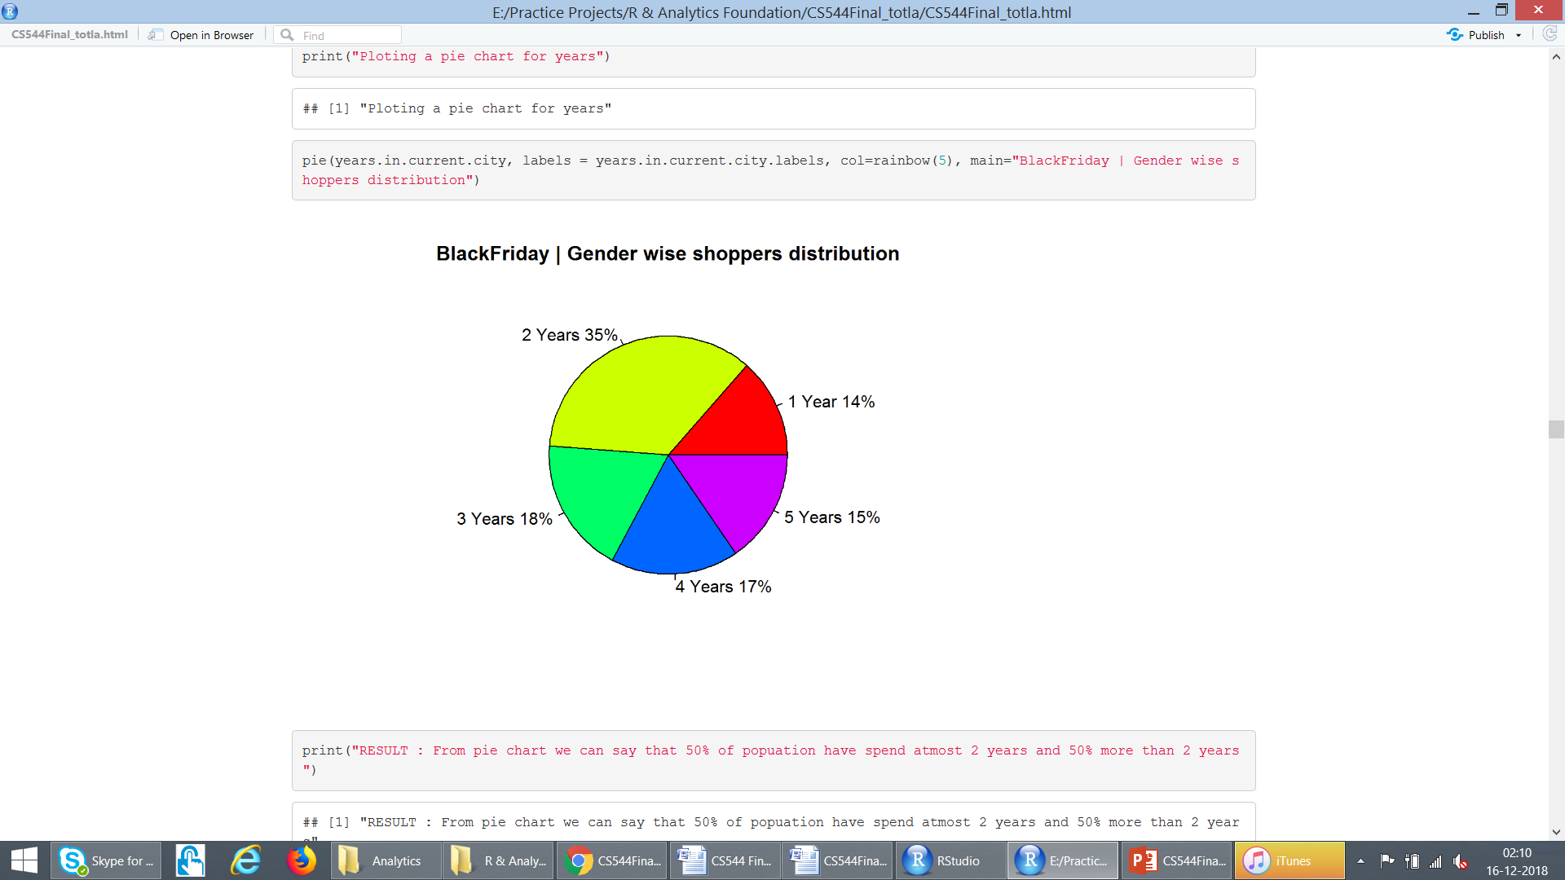
Analyse : “Years in Current City”

Slide 25
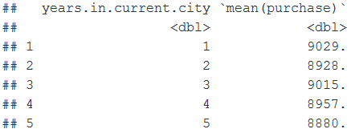
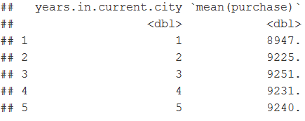
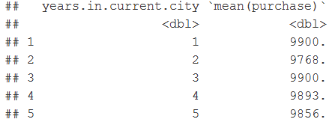
Other Observations (Used String/Tibble)
Average year a person live in following city:
A : 2.81
B : 2.88
C : 2.88
Average purchase in each city as per number of year :
A
B
C

Slide 26
Predictive Analysis
The models used to predict the purchase amount include
Linear regression
Random Forest regression
Gradient Boosting Machines
Deep learning regression
The package I used to build the model and train the data is h2o

Slide 27
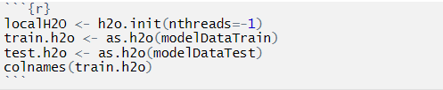
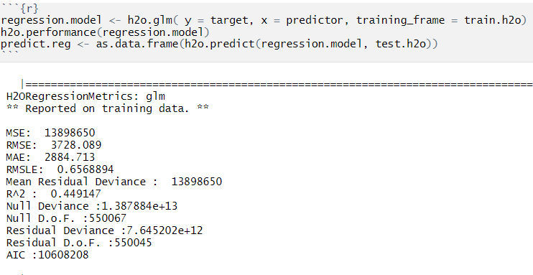
Linear regression
Modelling the data:-
Building the model:-

Slide 28
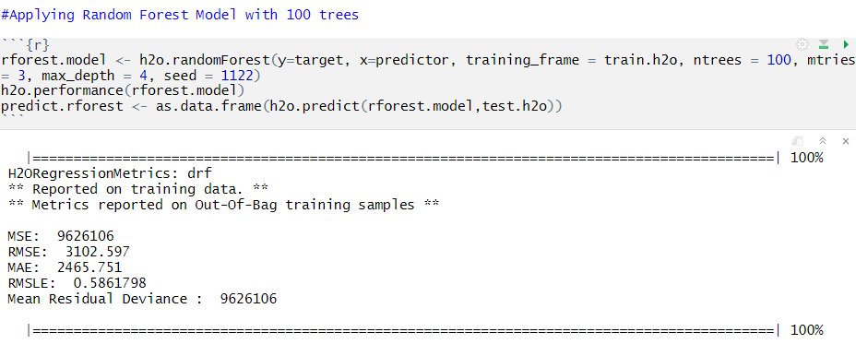
Random Forest regression
Modelling the data:-
Building the model:-

Slide 29
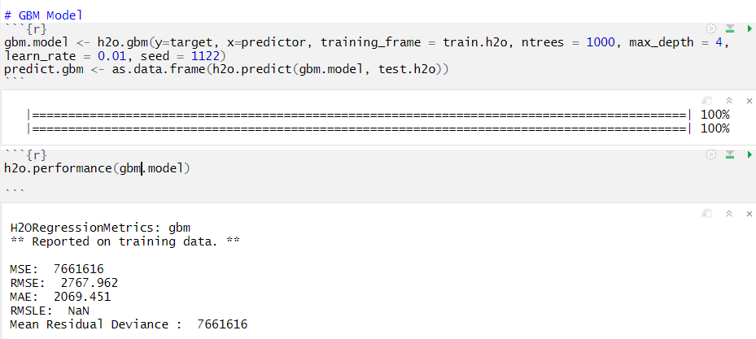
Gradient Boosting Machines
Modelling the data:-
Building the model:-

Slide 30
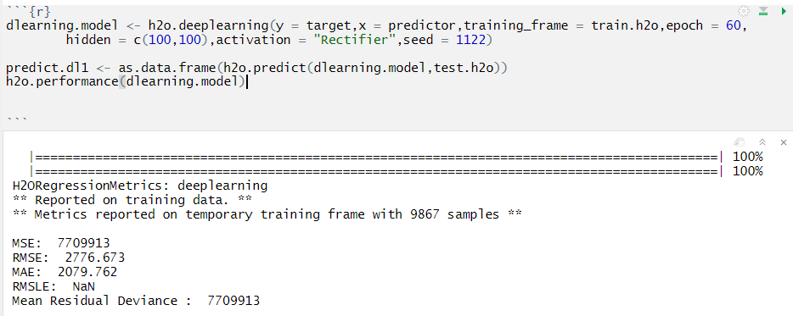
Deep Learning Regression
Modelling the data:-
Building the model:-

Slide 31
Summary of Regression models
Regression Model | MSE | RMSE | MAE | RMSLE | MEAN RESIDUAL DEVIANCE
General Linear Regression | 13898650 | 3428.089 | 2884.713 | 0.6568894 | 7.64e+12
Random Forest | 9626106 | 3102.597 | 2465.751 | 0.5861798 | 9626106
Gradient Boosting Machines | 7661616 | 2767.962 | 2069.451 | NaN | 7661616
Deep Learning Regression | 7709913 | 2776.673 | 2079.762 | NaN | 7709913
For this submission the main parameter checked is RMSE. The least in this case Gradient Boosting Regression and Deep Learning Regression .So for the submission we take the average of gbm and deep learning models result.

Slide 32
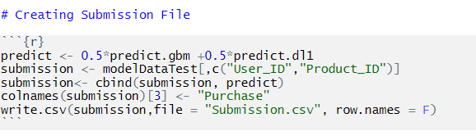
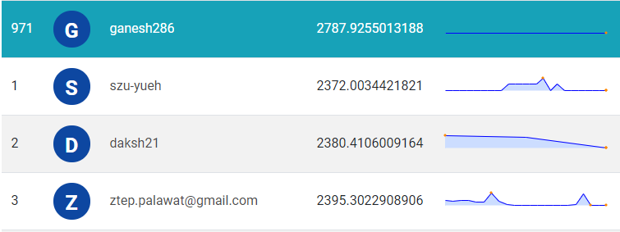
Final Submission and rank
The top submission till now has a RMSE of 2372.00344 and the file I uploaded has a RMSE of 2787.9255.My final rank is 971 out 21770 entries. This can be further improved by increased training

Slide 33
Conclusion
Number of Male Shoppers > Female Shoppers
Products in Product Category 2 sold most
People generally spent over $5000 in sales
People in age range 26-35 purchase most
There are highest average sales in City Category ‘C’ as compared to other
Unequal Probability sampling technique could be used over this dataset for best results
Deep Learning and gbm regression model proved to be more efficient than the other regression for this particular dataset

Slide 34
Thank you

